Slide 1
Update on MS Disease Modifying Therapies
Susan M. Rubin, MD
Ruth Cain Ruggles Chair, Department of Neurology
NorthShore University HealthSystem
December 9, 2023

Slide 2
Disclosures
I have nothing to disclose

Slide 3
Objectives
Participants will be able to:
  Describe the different mechanisms of action of the disease modifying therapies (DMTs)
  Recognize the safety concerns versus the efficacy of the new DMTs
  Understand the use of these DMTs in clinical practice.

Slide 4
History
Multiple Sclerosis was first recognized as a disease 1869 when it was named by Jean-Martin Charcot
  Sclerose en plaque disseminee
  Insular sclerosis, cerebrospinal sclerosis and ultimately multiple sclerosis
  Assumed to be infectious initially but in the 1920s it was recognized as an inflammatory reaction
  The importance of myelin, myelin basic protein and oligoclonnal bands were identified in the 1940s
Initial treatments
  Initial studies in 1960s showed ACTH was superior to placebo in speeding recovery
  Steroids were found to help as well.
  Focus was on both inflammation and infection
  Interferons that were known to modulate the immune system and a copolymer made up of myelin protein fragments could protect patients against the disease and were the first medications approved in the 1990s
Murry, TJ. Multiple Sclerosis: a history of a disease. Demos Medical Publishing.New York, New York. 2005

Slide 5
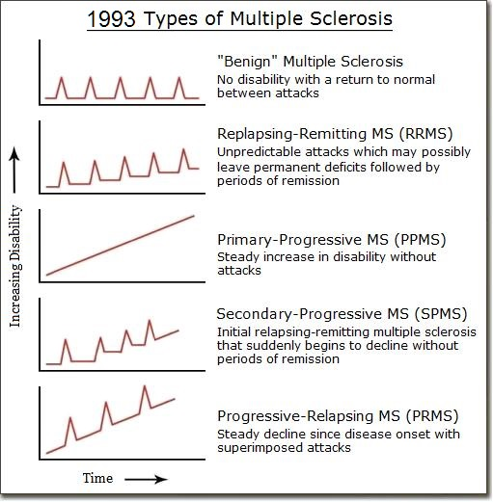
Clinical Course

Slide 6
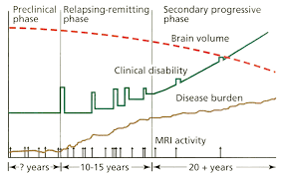
Natural History of Relapsing Remitting Disease

Slide 7
Advantages of Disease Management
Reduced disease activity
Delayed transition to secondarily progressive disease
Reduced disability
Decreased brain atrophy
All of our treatments are designed to prevent active inflammation

Slide 8
Current Treatment Options
26 medications are now available on the market including generic formulations
One has been removed from the marketplace due to side effects
Self injectable medications
  Interferon Beta 1B (Betaseron/Extavia)
  Interferon Beta 1A IM(Avonex)
  Interferon Beta 1A SQ (Rebif)
  Peginterferon (Plegridy)
  Glatiramer Acetate (Copaxone/Glatopa/generic formulation)
  Ofatumumab (Kesimpta)
Oral medications
  Terfludimide (Aubagio/generic formulation)
  Fingolimod (Gilenya/generic formulation)/Siponimod (Mayzent)/Ozanimod (Zeposia)/Ponesimod (Ponvory)
  Dimethyl Fumarate (Tecfidera/generic formulations)/Diroximel Fumarate (Vulmerity)/Monomethyl Fumarate (Bafiertam)
  Cladrabine (Mavenclad)
Infusion medications
  Natalizamab (Tysabri)
  Ocrelizamab (Ocrevus)/Ublituximab (Briumvi)
  Alemtuzamab (Lemtrada)
  Mitaxantrone (Novantrone)

Slide 9
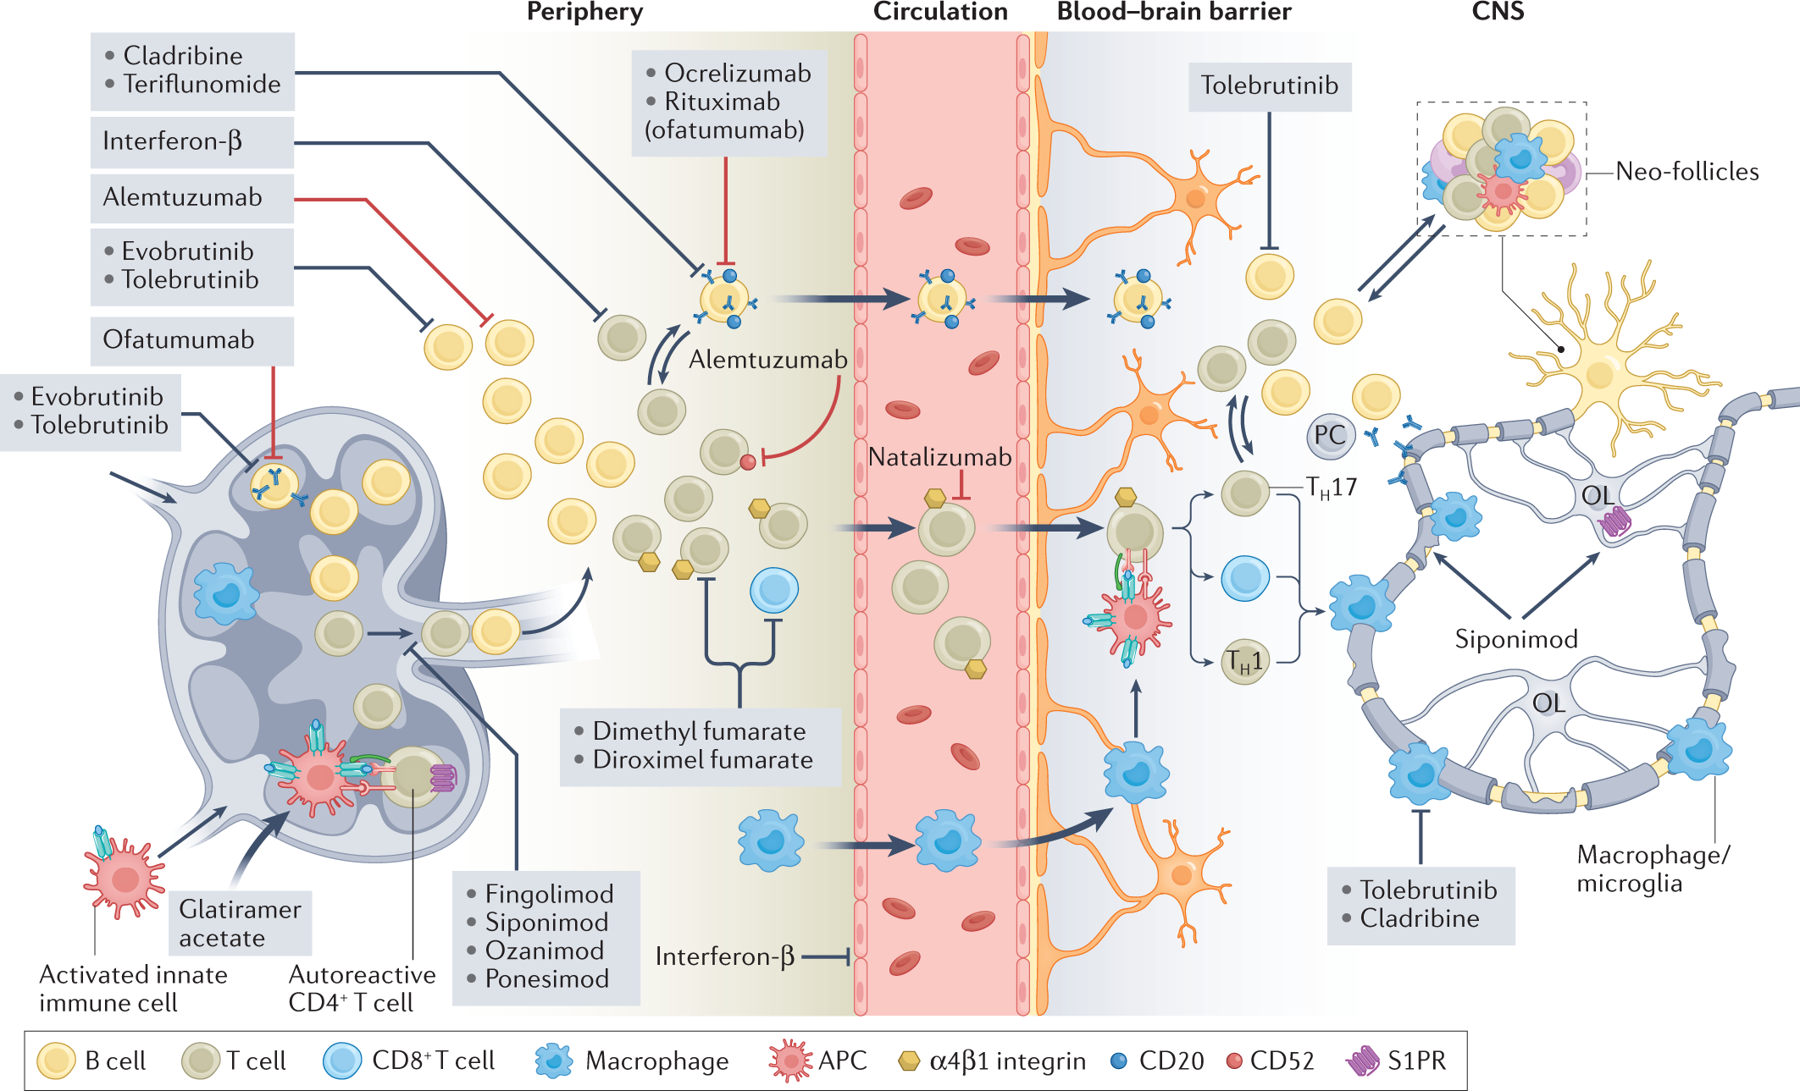
Bierhansl, L, et al. Thinking outside the box: Non-canonical targets in Multiple Sclerosis. Nature Reviews Drug Discovery, June 2022; 21, 578-600

Slide 10

RRMS treatment:
Different mechanistic approaches¹⁻⁶
Immune
modulation
Reduction in cell trafficking
Immune cell sequestration
Immune cell ablation
1. Weber MS, et al. Neurotherapeutics. 2007;4(4)647-653. 2. Aharoni R, et al. Proc Natl Acad Sci U S A. 2008;105(32):11358-11363. 3. Betaseron® prescribing information. Bayer HealthCare Pharmaceuticals Inc. 4. Tysabri® prescribing information. Biogen Idec Inc. 5. Lopez-Diego RS, et al. Nat Rev Drug Discovery. 2008;7(11):909-920. 6. Giovannoni G, et al. N Engl J Med. 2010;362(5):416-426.
Notes:
RRMS treatment: Different mechanistic approaches
The approved therapies, as well as certain emerging treatments, provide us with different therapeutic approaches to treat our relapsing-remitting multiple sclerosis (RRMS) patients. We are all familiar with immune modulation and reduction in cell trafficking, but there are many unknowns surrounding the
long-term effects of immune cell ablation and sequestration

Slide 11
Disease Modifying Medications
Self Injectable medications
  Interferons (Betaseron, Avonex, Rebif, Plegridy)
    MOA: Reduces antigen presentation and T-cell proliferation, alters cytokine and matrix metalloproteinase (MMP) expression, and restores suppressor function
    Pros: 30-40% reduction in relapse rate, no new safety signals, multiple injection types and frequencies
    Cons: Flu-like symptoms, injection reactions, depression, thyroid dysfunction, liver dysfunction
  Glatiramer Acetate (Copaxone, Glatopa)
    MOA: shifts the population of T cells from proinflammatory Th1 T-cells to regulatory Th2 T-cells that suppress the inflammatory response
    Pros: 30% reduction in relapse rate, no new safety signals, variable dosing schedule, no flu-like reactions
    Cons: Injection reactions, immediate post dose reactions
  Ofatumumab (Kesimpta)
    MOA: targets the CD20-positive B-cells protecting the nerve cells from mediated damage caused by CD20-positive B lymphoma cell lines
    Pros: 50% efficacy, monthly self injection, also approved for active secondary progressive disease
    Cons: injection reactions, immunosuppression, breast cancer and infections

Slide 12
Disease Modifying Medications
Oral medications
  Fingolimod/Siponimod/Ozanimod/Ponesimod
    MOA: a sphingosine 1-phosphate receptor modulator binding with high affinity to sphingosine 1-phosphate receptors 1, 3, 4, and 5 blocking the capacity of lymphocytes to egress from lymph nodes, reducing the number of lymphocytes in peripheral blood
    Pros: 50% reduction in relapse rate, no injections, once a day, Siponimod also tested in secondary progressive disease with a 20% reduction in the rate of disability
    Cons: Pre and post dose monitoring for heart (newer formulations do not require this), eye and skin conditions,, infection risk including rare cases of PML,
  Dimethyl Fumarate/Diroximel Fumarate/Monomethyl Fumarate
    MOA: activates the Nrf2 transcriptional pathway resulting in intraneuronal synthesis of the antioxidant glutathione (GSH) mediated through the Nrf2; additional immunomodulatory actions for dimethyl fumarate mediated through nitric oxide, interleukins, tumor necrosis factor (TNF-α), or other cytokines.
    Pros: 50% reduction in relapse rate, no injections, no significant monitoring needed
    Cons: twice a day, GI upset, flushing, low lymphocyte count, rare cases of PML
  Teriflunimide
    MOA: inhibits dihydroorotate dehydrogenase, a mitochondrial enzyme involved in de novo pyrimidine synthesis.
    Pros: 30% reduction in relapse rate, no injections, once a day
    Cons: Hair loss, liver function abnormalities, contraindicated in pregnancy

Slide 13
Disease Modifying Medications
  One additional oral medication
  Cladribine (Mavenclad): Study focused on relapsing remitting disease (impacts both T and B cells)
    MOA: helps in the rapid reduction of natural killer cells with minimal impact on neutrophils, platelets and monocytes.
    Pros: 50% reduction in relapse rate, yearly treatment cycles only, only two years of treatment
    Cons: increased infection risk, questionable cancer risk

Slide 14
Disease Modifying Medications
Infusions
  Natalizumab (Tysabri)
    MOA: reduce the transmission of immune cells into the central nervous system by interfering with the α4β1-integrin receptor molecules on the surfaces of cells expressing the VCAM-1 gene
    Pros: 67% reduction in relapses, once a month, well tolerated
    Cons: PML, JCV testing every six months, can’t take immunosuppressants
  Alemtuzumab (Lemtrada)
    MOA: targets CD52, a protein abundant on T and B cells which depletes circulating T and B lymphocytes after each treatment course
    Pros: 49-55% efficacy, Once a year dosing, only two years of required treatment, slowed disability
    Cons:infusion reactions, thyroid, platelet and kidney dysfunction, prolonged immunosuppression, infections
  Ocrelizumab (Ocrevus)/Ublituximab (Briumvi)
    MOA: targets the CD20-positive B-cells protecting the nerve cells from mediated damage caused by CD20-positive B lymphoma cell lines
    Pros: 54% efficacy, twice a year dosing, also improved for primary progressive disease
    Cons: infusion reactions, immunosuppression, breast cancer (?) and infections
  Mitaxantrone (Novantrone)
    MOA: intercalation with the DNA molecule potently inhibiting proliferation of B and T lymphocytes as well as macrophages.
    Pros: Slows disability, once every three months treatments
    Cons: Maximum of 2 years of treatment due to cardiomyopathy

Slide 15
How to chose the right treatment
Individualized management
  Consideration of prognostic factors
  Consideration of personal patient concerns
Prognostic Factors (for a poor prognosis)
  Male gender
  African heritage
  Older age of onset
  Motor symptoms or ataxia at onset
  Incomplete recovery from relapses
  Frequent relapses (2 or more in 2 years)
  Brainstem or spinal cord lesions at onset
Patient Concerns
  Safety
  Pregnancy plans
  Lifestyle

Slide 16
Other factors found to predict prognosis
Presenting initially with optic neuritis instead of other symptoms has a better longterm outcome.
Having OCB in the spinal fluid had a medium impact on prognosis
Having more than 10 lesions on MRI at presentation increased the risk of progression in disability by 3 fold.
Starting DMTs early reduced the risk developing CDMS or progressing
Tintore, M et al. Defining high, medium and low impact prognostic factors for developing MS. Brain. 2015; 138 : 1863-1874

Slide 17
Induction vs Escalation Therapy
Definition
  Escalation Therapy: Starting with the lowest efficacy but best safety profile medications and changing to a higher efficacy medication only with evidence of breakthrough disease
  Induction therapy (now called immune reconstitution therapy): Starting with a high efficacy medication from the start to induce remission and prevent breakthrough disease and the need for a new therapy
Rationale for escalation therapy
  No good unbiased head to head studies to prove differences in efficacy
  Many patients do well on their first medication so why risk safety
Rationale for induction therapy
  Relapses and new MRI changes are greatest at the onset of MS when patients are youngest
  Failure rates and intolerance of the older injectables are high enough that many patients will transition to a more tolerable and efficacious product anyway.

Slide 18

Matching patients and treatment:
Changing considerations
Patient Types
Treatment
Considerations
Newly diagnosed
RRMS patients
Efficacy
Evolving Treatment
Considerations
Impact on immune
function
Patients presenting
with CIS/first event
Safety/tolerability
Patients with suboptimal response to current DMT (efficacy/tolerability)
Disease/treatment
history
Treatment strategy
Patients requesting a change in administration
Patient needs/ expectations
Sustainable
long-term treatment
CIS=clinically isolated syndrome.
DMT=disease-modifying therapy.
RRMS=relapsing-remitting multiple sclerosis.
Notes:
Matching patients and treatment: Changing considerations
What are the considerations for making treatment decisions in the evolving landscape?
We know that matching patients with the appropriate therapy will become increasingly complex as new options become available
On the left, we feature our common treatment scenarios. Those we are most familiar with include newly diagnosed RRMS patients, those presenting earlier in the disease course (CIS), and patients with suboptimal response to DMT (efficacy, safety, and/or tolerability)
The new type of scenario you’ll encounter if/when oral treatments become available will involve patients requesting a change in administration
This right box features traditional treatment considerations. As always, assessing the benefits and risks of treatment options will guide the therapy choice. Efficacy, safety/tolerability, and a patient’s disease severity and treatment history are factors that have traditionally driven the treatment decision
Additionally, patient needs, such as lifestyle issues, are a key consideration, related to one’s ability to stay compliant/adherent with treatment
In the context of some of the emerging therapies, and the way these new entrants are believed to target the immune system, potential impact on immune function, treatment approach, and the sustainability of treatment will take on new importance as treatment considerations¹
1. Winnington P. Practic Neurol. 2010;1/2:27-30.
18

Slide 19
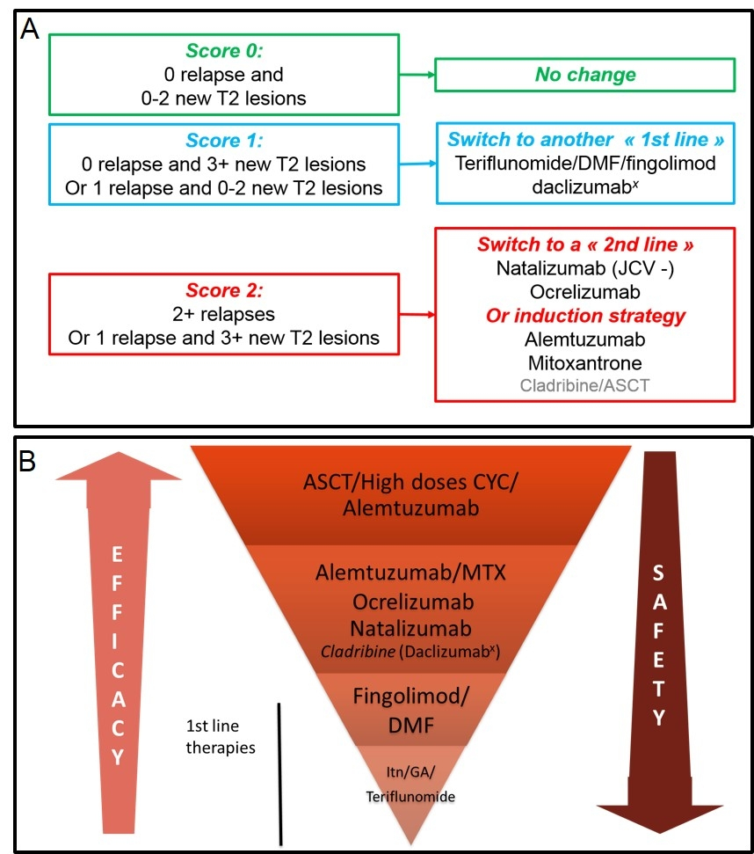
Jens Ingversen, et al. Advances in and Algorithms for the treatment of Relapsing –Remitting Multiple Sclerosis
Neurotherapeutics, Dec 2015; 13, 47-57

Slide 20
New targets in trials
BTK inhibitors
CD40/CD40L inhibitors.
Stem Cells.
Nutritional and repurposed medications.

Slide 21
Burton Tyrosine Kinase Inhibitors (BTKi)
BTK is implicated in peripheral and central inflammation in MS
  Therapeutic target
Cytoplasmic tyrosine kinase
  Phosphorylates tyrosine from ATP
Signal transducer of B cell receptors, chemokines, cytokines, Fc receptors (not T cells)
  Antigen binding to BCR leads to BTK activation and leads to B cell proliferation, maturation, differentiation, cytokine expression
Whang JA, Chang BY. Drug Discov Today 2014;19:1200–1204.
Crawford J, et al. J Med Chem 2018;61:2227–2245.
Weber MS, et al. Presented at AAN 2021 (Presentation number P15.091).
Notes:
In MS, the detrimental effects of activated macrophages and microglia, such as myelin phagocytosis and cytokine secretion, are mediated via the Fc receptor and tumor necrosis factor α (TNFα) via toll-like receptor-4 (TLR-4) on the cell surface with subsequent BTK activation

Slide 22
Bruton Tyrosine Kinase Inhibition in Multiple Sclerosis
Practical neurology, Feb 2022

Slide 23
Mechanism of Action
Preclinical studies showed benefit in EAE models
  Decreased T-cell proliferation, inhibitions of BCR mediated B-cell activation and production of proinflammatory cytokines (interferon γ), reduce B-cell antigen presentation, inhibit BTK activity in microglia
  Decreased B-lymphocyte maturation and differentiation in lymph nodes without affecting number
    Less B-cell immunodeficiency
  Promote Remyelination?
  Decreased disease severity in a dose-dependent manner
Bruton Tyrosine Kinase Inhibition in Multiple Sclerosis
Practical neurology, Feb 2022

Slide 24
CD40/CD40L
Inhibits CD40/CD40L costimulatory signaling pathway impacting both innate and adaptive immunity.
  Innate immune cells work as the bodies first line defense.
  Adaptive immune cells are activated cells that recognize specific pathogens.
Previous trials have been stopped due to blood clots/thromboembolic events.
May impact progression as well as inflammation.
Phase two studies show a significant reduction in Gad-enhancing and T2 lesions

Slide 25
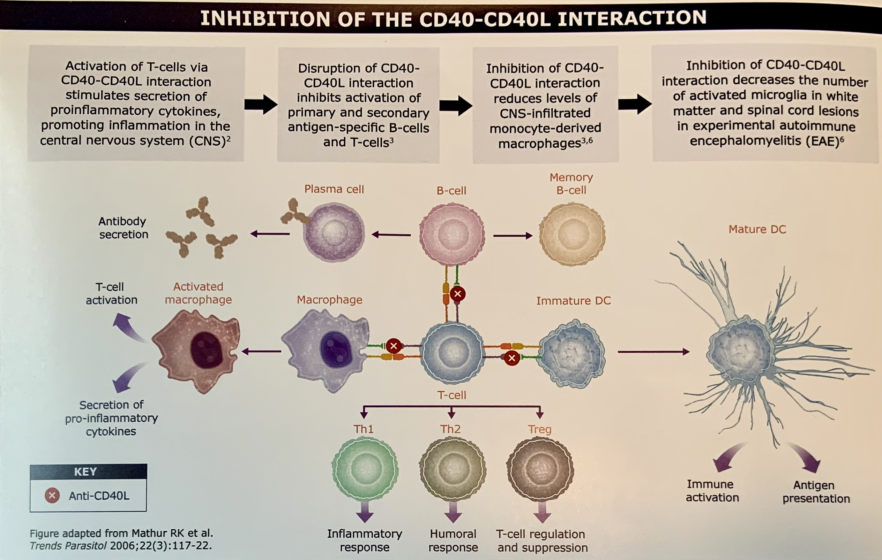

Slide 26
Stem cell therapy in MS
Designed to reset the immune system to stop it from attacking the CNS
May allow for remyelination
Requires immune suppression before stem cell transplantation raising the question of whether the immune suppression or stem cells are really causing the remission.
66% of those who underwent stem cell therapy had no activity 5 years later.
Still considered experimental treatment.

Slide 27
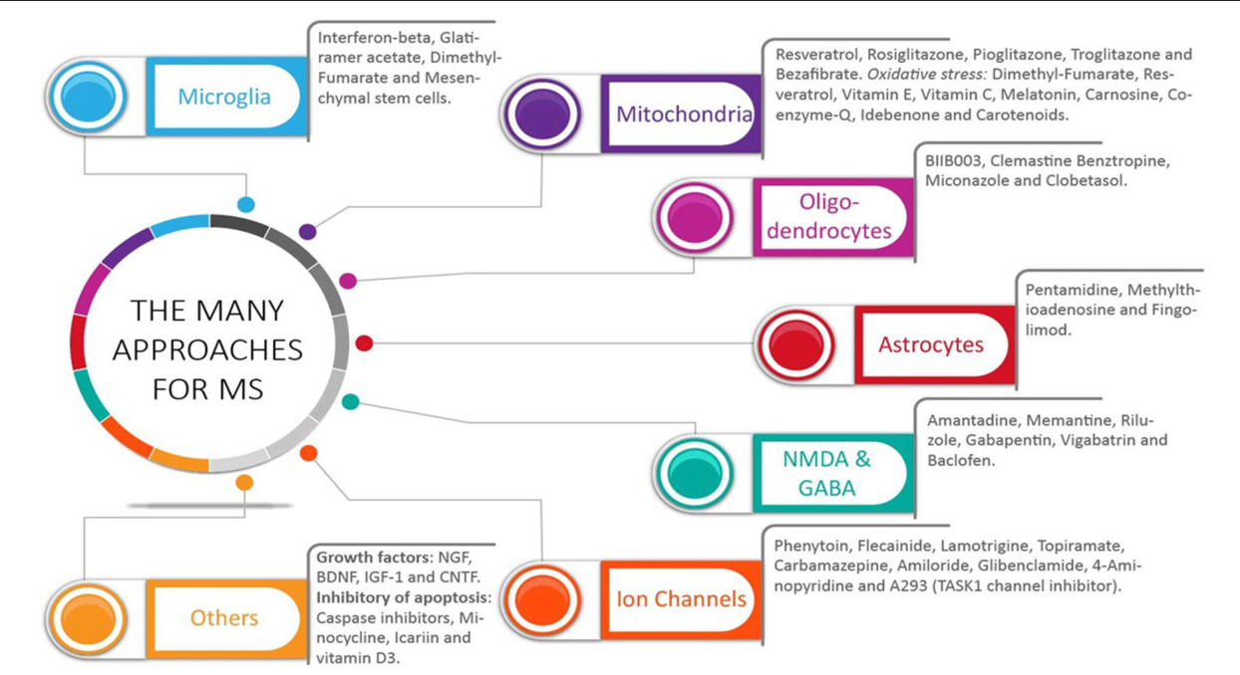
Other Targets
LoPresti, P. Silent Free Fall at Disease Onset: A perspective on therapeutics for Progressive Multiple Sclerosis. Frontiers in Neurology, Nov 2018

Slide 29
Conclusions
es
There are multiple mechanisms to control MS
Decisions on treatment needs to consider prognostic factors and patient preference.
Debate continues on whether escalation therapy or induction therapy provides the best initial treatment choice.
New options for management undergoing study include BTK inhibitors, CD40/CD40L modulators, stem cells and even repurposed medications

